Slide 1
Ti - BJP Update
Victor Villarini
March 1st, 2023
TriTech Titanium Parts LLC
Detroit, Michigan

Slide 2
TriTech Overview
TriTech Titanium Parts was formed on April 5, 2022 as a spin-off from AmeriTi Manufacturing Company located in Detroit, Michigan.
Parts Division has been operating since 2015.
ISO 9001:2015 Certified.
TriTech’s unique business plan combining technologies for the customer.
Investment Casting.
Metal Injection Molding.
3D Binderjet Printing.
Most popular alloys produced are Ti-6Al-4V and CP Ti.
PM part size ranging from 0.2 to 250 grams.
IC part size can be much larger up to 20 pounds.
Prototype capability for all processes.

Slide 3
AM Start-Up
TriTech entered into metal additive in 2022
Big learning curve for new process
Key Points
Powder handling
Software
Printed part preparation
Tolerance capability
Business development

Slide 4
3D Binderjet Printing
Process developed on entry level production system coined P1.
This was the correct piece of equipment due its unique features
Inert environment
Process speed
Current speed internally ~ 3 min/mm
Green density capability
Customizability
Software suite
Fabricate MFG
Live Sinter
P1 Interface

Slide 5
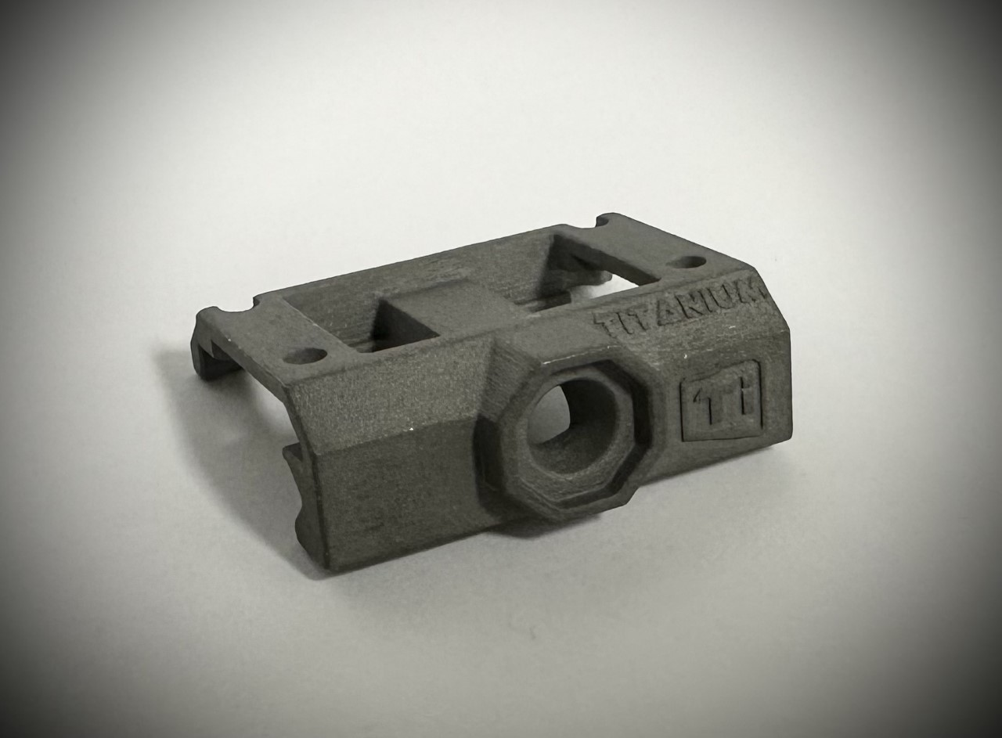
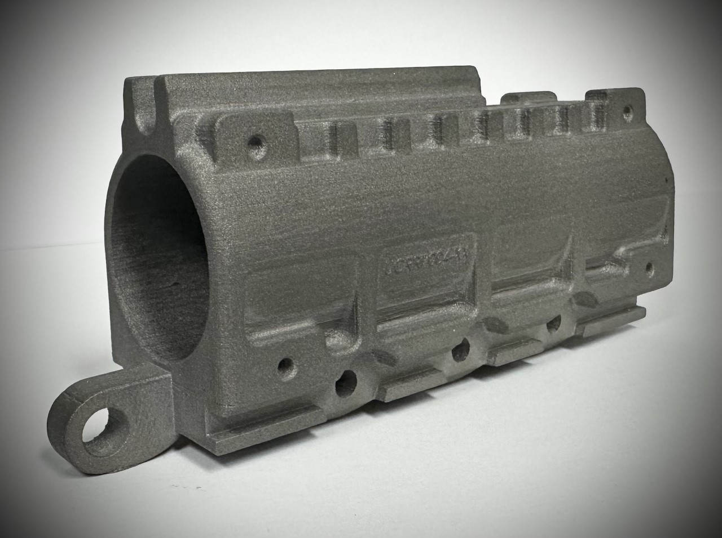
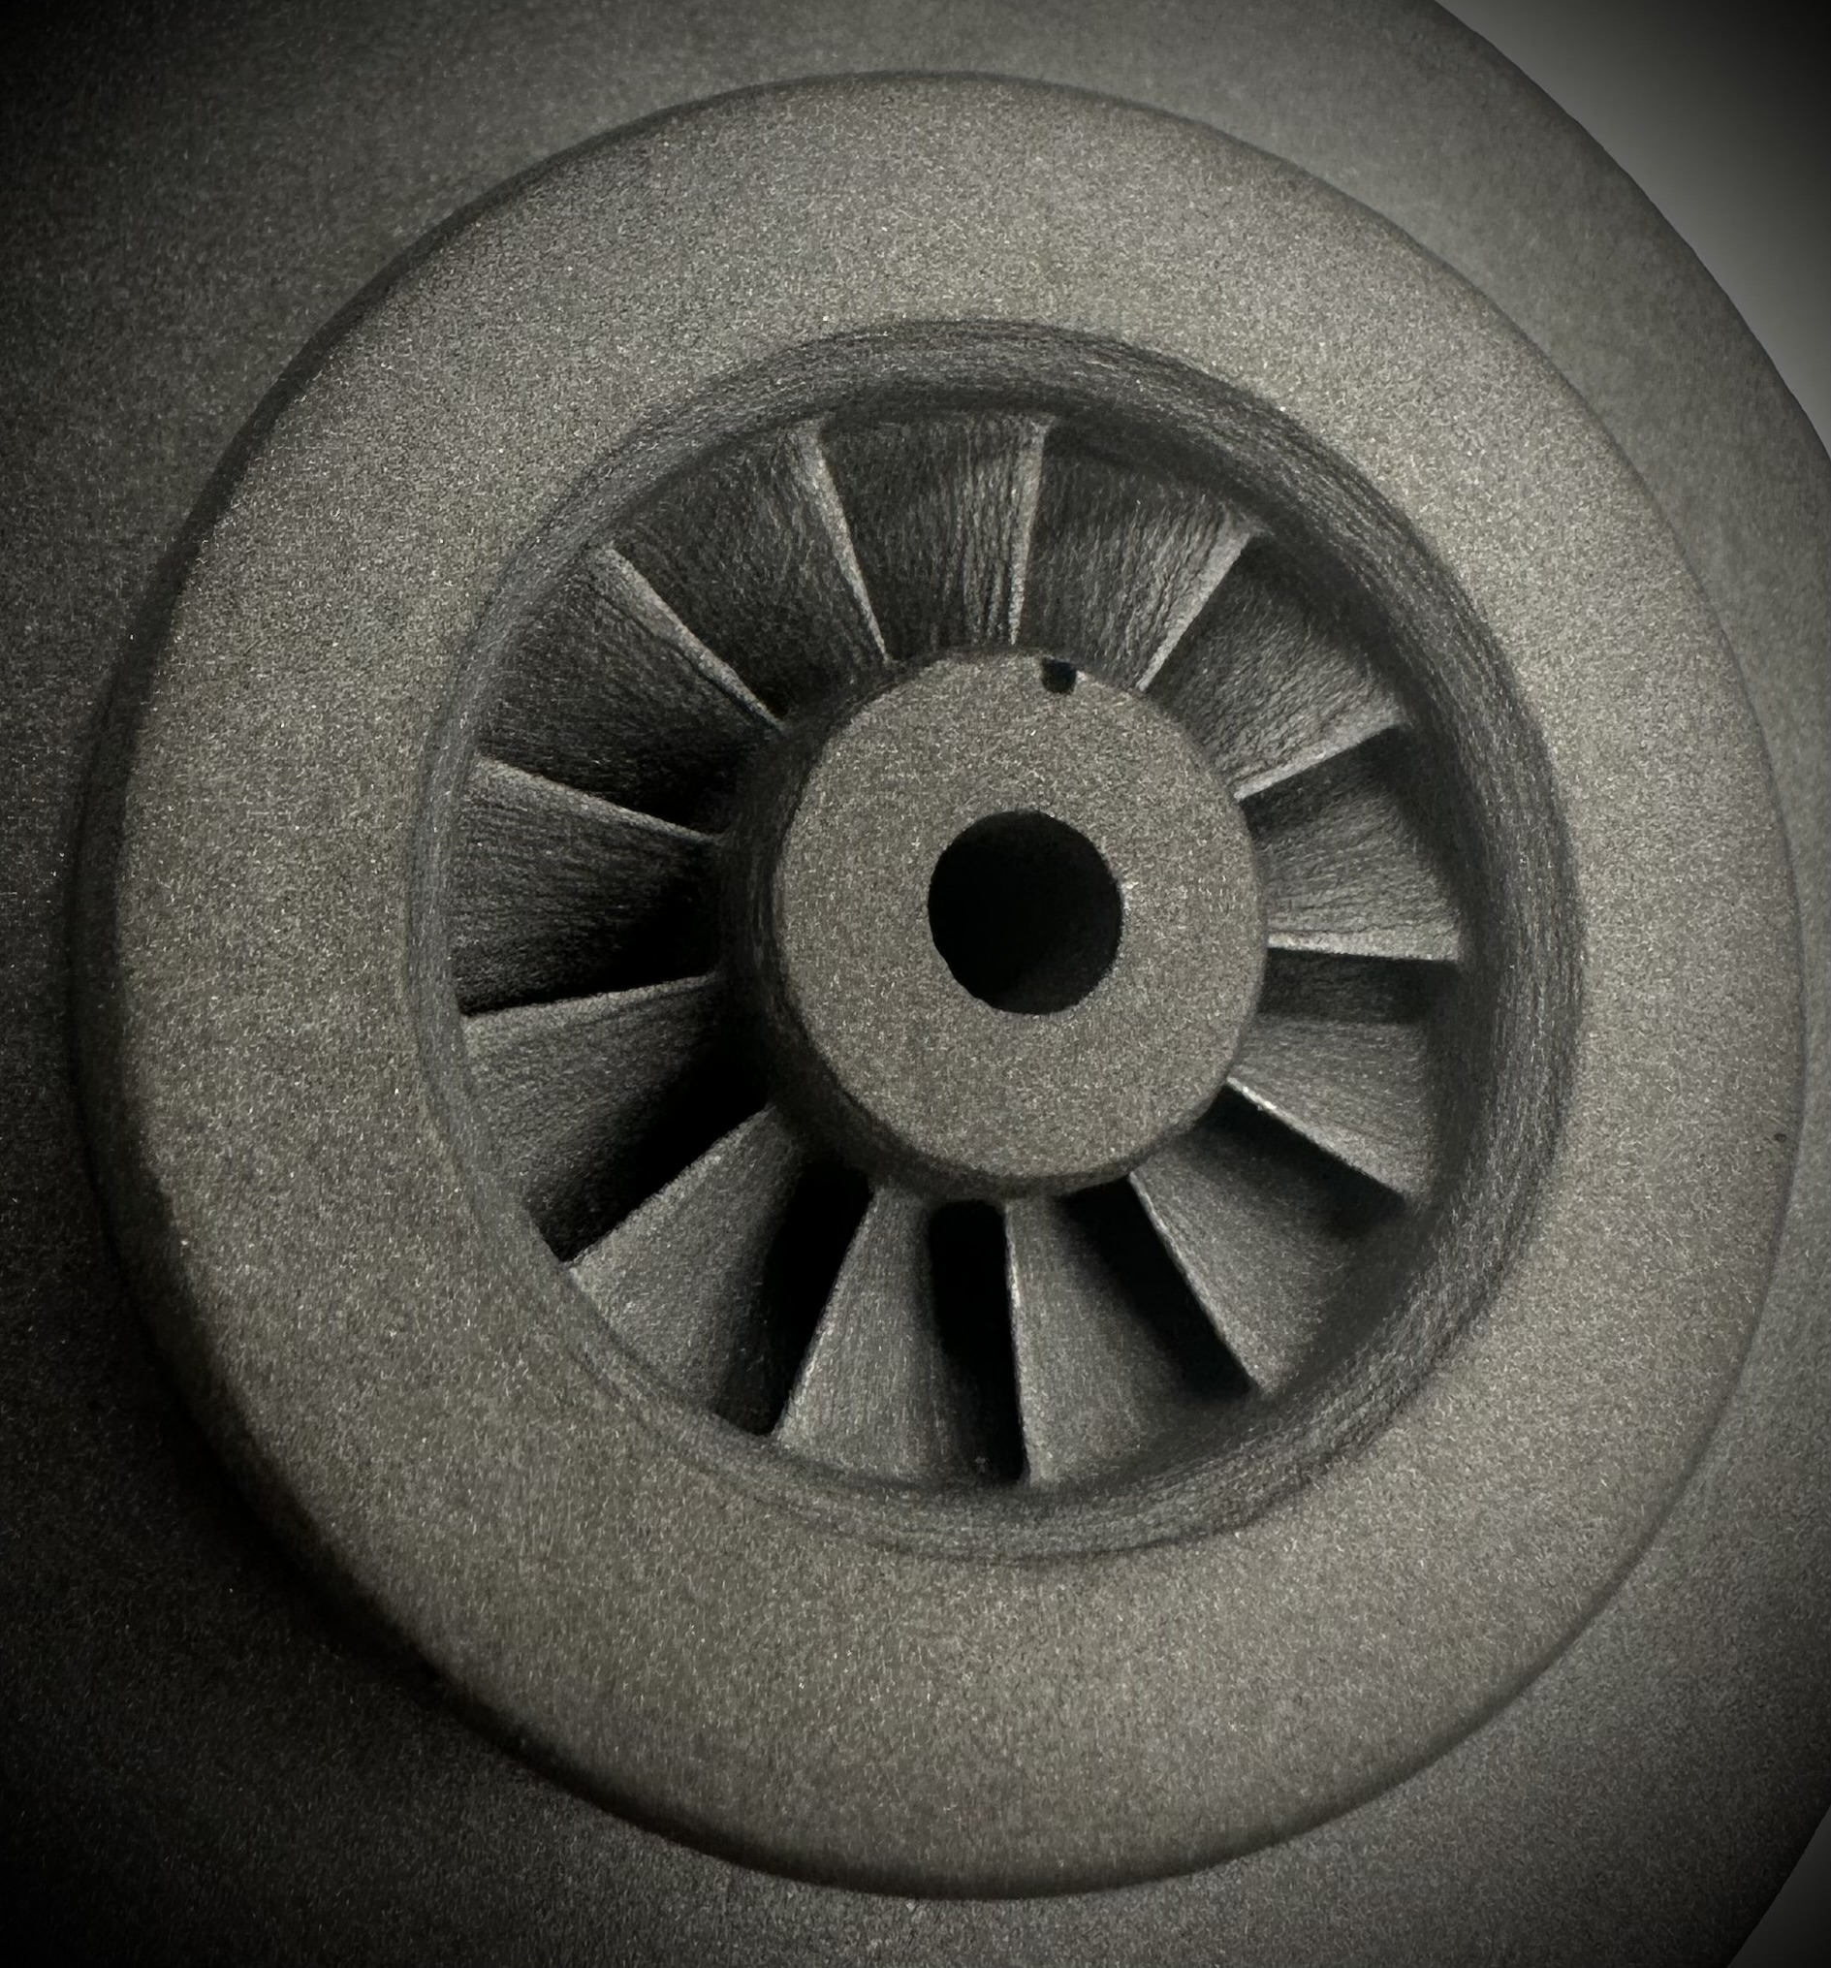
3D Binderjet Printing
Capability Overview
Grade 5 Titanium.
Up next → CP Ti and Aluminum Alloys
Tolerances, +/- 1% (or better).
Typically, +/- 0.006” in process.
Surface roughness consistently < 5 um Ra.

Slide 6
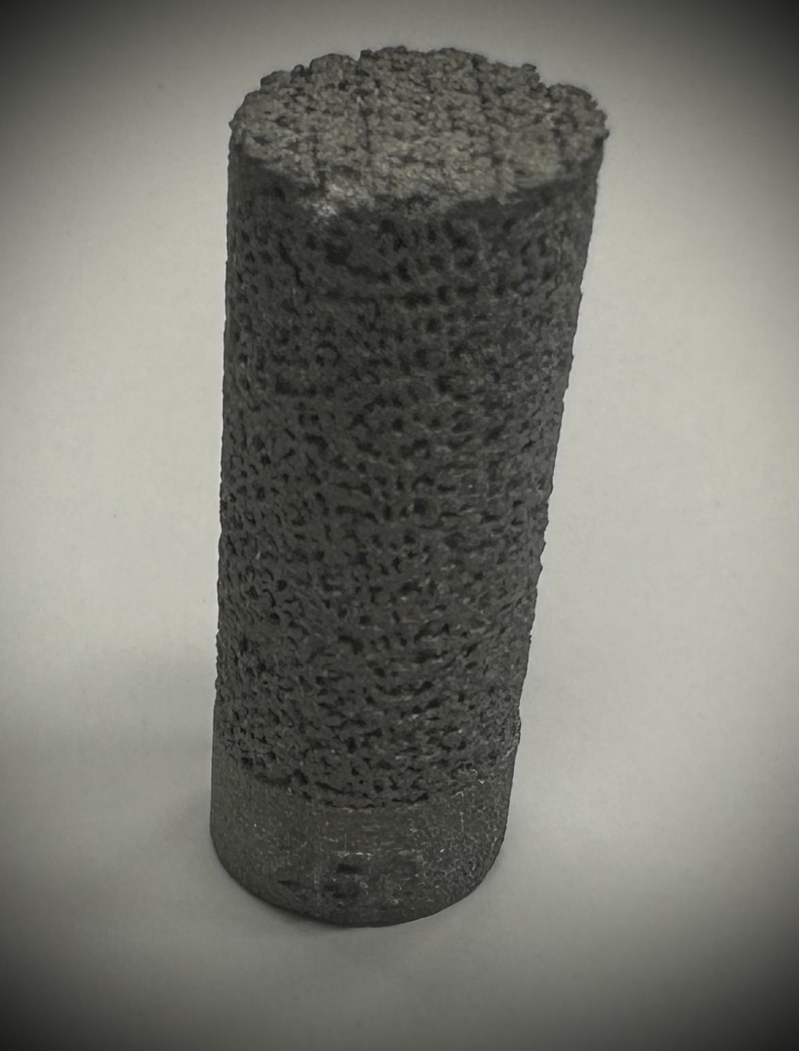
3D Binderjet Printing

Slide 7
How BJP Benefits 3T
Low initial investment
No tooling
Short lead time
Complex geometry freedom
Design iteration freedom
Competitive prototype cost
Fastest metal AM process
Similar properties to more familiar MIM Titanium

Slide 8
Ti-BJP Successes
Grade 5 Product.
P1/DM software knowhow and parameter development
Complex part processing.
Two powders developed on platform. More to come.
New tool in our toolbox.

Slide 9
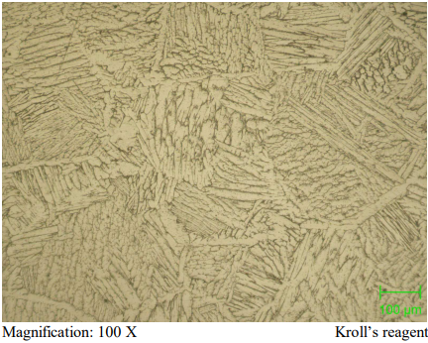
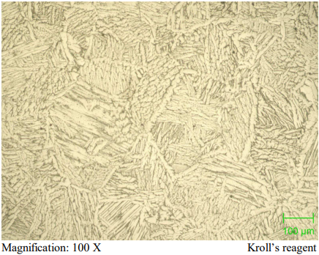
Ti-BJP Successes
As Sintered Microstructure
Metal Injection Molded
Binder Jet Printed

Slide 10
Ti-BJP Successes
AS-SINTERED - Ti-6Al-4V | MIM | BJP | Billet Spec.
Tensile Strength (MPa) | 939 | 948 | 896
Yield Strength (MPa) | 887 | 857 | 827
% Elongation | 9 | 8 | 10
Density (g/cm³) | 4.36 | 4.10 | 4.42

Slide 11
Remaining Ti-BJP Challenges
Sintered density
Capacity constraints
Tolerance band
Build box constraints
Green Strength

Slide 12
TriTech BJP Summary
What has TriTech achieved:
Successful development and startup of Ti binderjet printer.
ASTM B988 Grade 5 achieved.
.06% C and .20% max oxygen capable.
Workable green strength allowing for more complex part depowdering.
BJP Compliments MIM
It is becoming a stable and developed process
Not the lowest cost, but with - 0 - tooling it is attractive.
Friendly to complex shapes without complex tooling.
Easy to produce live setters. A printed support structure that supports the part.
Internal passages, porous shapes, and more.
Room for improvement on surface and tolerances.
Lots of room to grow.
Prototyping for MIM parts made easier.

Slide 13
Thank You
Detroit, Michigan

